Slide 1
CERN Testbeam Results on BTL
Adi Bornheim, Jay Lawhorn, Aashrita Mangu, Cristián Peña, Maria Spiropulu, Si Xie, Zhicai, Zhang
California Institute of Technology
??? Meeting
06/30/2016

Slide 2
CERN Testbeam Results on BTL
Adi Bornheim, Jay Lawhorn, Aashrita Mangu, Cristián Peña, Maria Spiropulu, Si Xie, Zhicai, Zhang
California Institute of Technology
??? Meeting
06/30/2016

Slide 3
Reproduce NINO results
Use Runs 7803-7830:
  100mV NINO threshold
  Bias Voltage: 34V (?? Not 100% sure – need to check with Marco)
  Use channels 5 & 6 : 5x5mm^2 FBK NUV HD 20μm pitch on 11x11x4mm LYSO:Ce
NINO timestamp is reconstructed by linear fit to the leading edge and taking the time when it crosses the 200ADC threshold
NINO time stamp exhibits dependence on signal amplitude – as expected

Slide 4
Reproduce NINO results
Use Runs 7803-7830:
  100mV NINO threshold
  Bias Voltage: 34V (?? Not 100% sure – need to check with Marco)
  Use channels 5 & 6 : 5x5mm^2 FBK NUV HD 20μm pitch on 11x11x4mm LYSO:Ce
NINO timestamp is reconstructed by linear fit to the leading edge and taking the time when it crosses the 200ADC threshold
Before amp
corrections
After amp
corrections
Only Run 7807
Only Run 7807

Slide 5
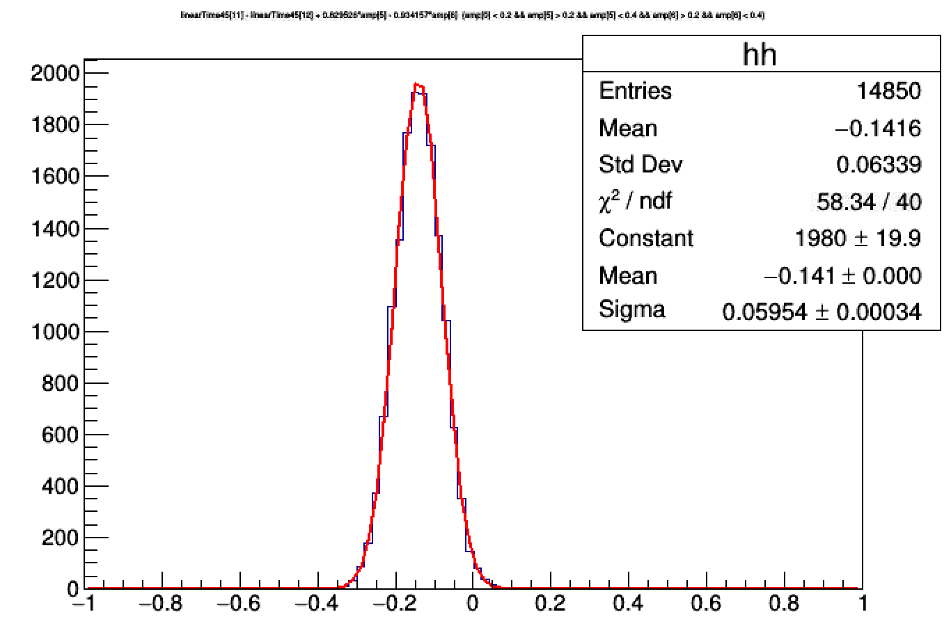
Reproduce NINO results
Use Runs 7803-7830:
  100mV NINO threshold
  Bias Voltage: 34V (?? Not 100% sure – need to check with Marco)
  Use channels 5 & 6 : 5x5mm^2 FBK NUV HD 20μm pitch on 11x11x4mm LYSO:Ce
NINO timestamp is reconstructed by linear fit to the leading edge and taking the time when it crosses the 200ADC threshold
Get 60ps resolution between 2 sensors
Dividing by sqrt(2) gives 42ps for each sensor
With quadratic amp correction we get 40ps resolution for each sensor
Marco says they got 36ps
Results are relatively close
All Runs from 7803-7830

Slide 6
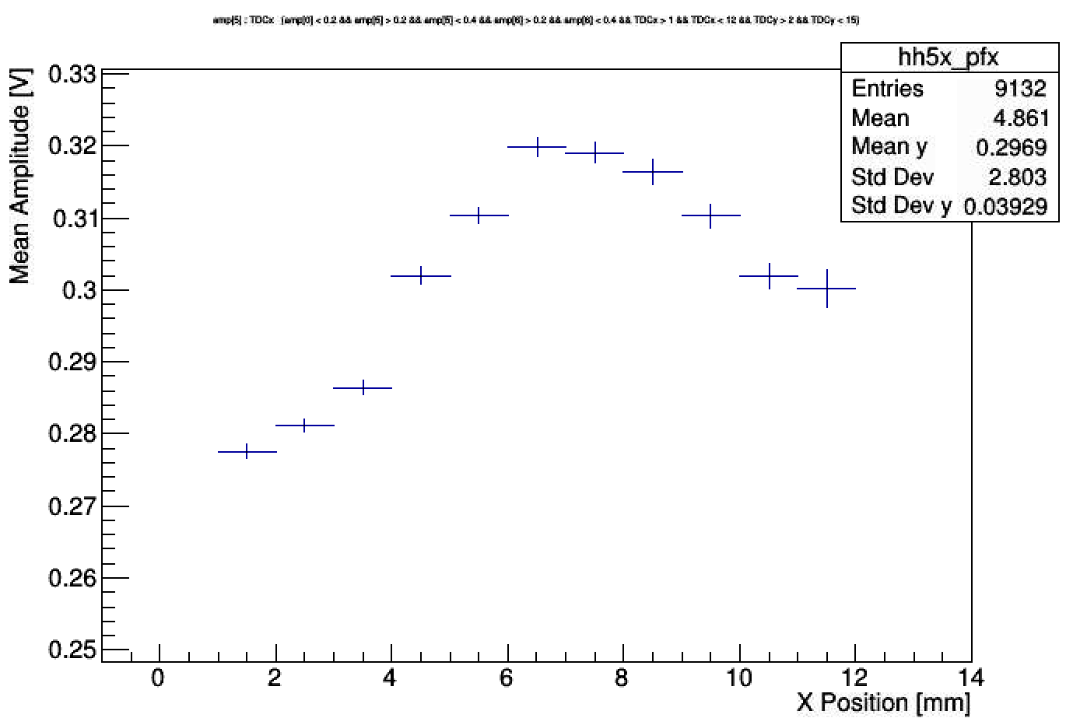
Use Photek as Reference Timer
Use Runs 7803-7830, now measure deltaT of Channel 5 with respect to Photek time
There’s a correlation between deltaT and amplitude. When amplitude is highest, the signal comes earlier

Slide 7
Use Photek as Reference Timer
Use Runs 7803-7830, now measure deltaT of Channel 5 with respect to Photek time
There’s a correlation between deltaT and amplitude. When amplitude is highest, the signal comes earlier

Slide 8
Use Photek as Reference Timer
Use a small region in X & Y, and perform linear time correction vs X/Y
  X: 2 – 6 mm
  Y: 4 – 8 mm
Amplitude correction
then
X/Y correction
X/Y correction
then
Amplitude correction
Get 50ps resolution at best
It’s worse than resolution measured from considering 2 identical sensors (recall : we get 40ps there)

Slide 9
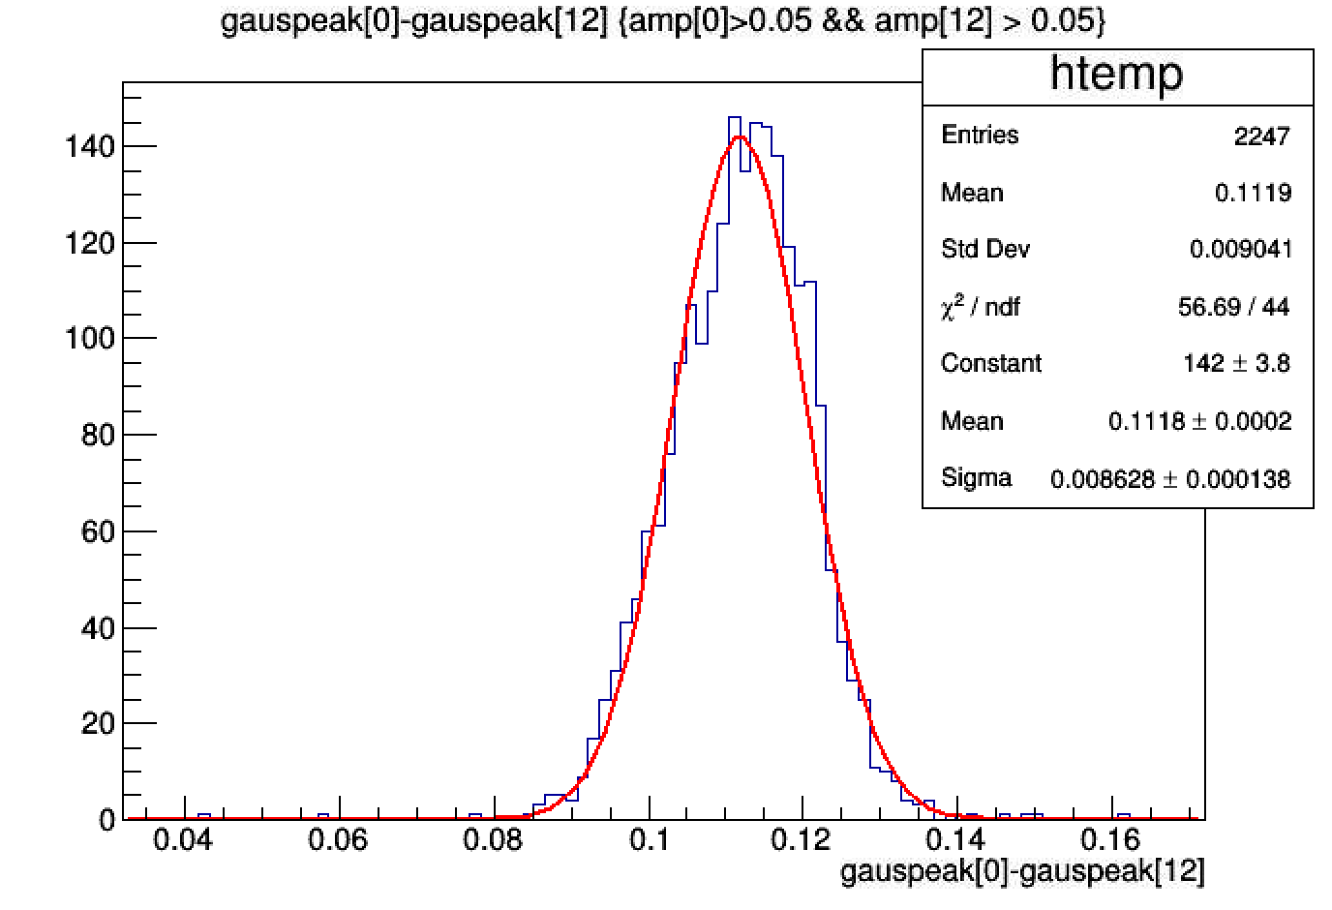
Digitizer Resolution
Use photek signal, split with a “T” and input to two channels in the same group of the digitizer
Get about 7-9ps resolution depending on the channel

Slide 10
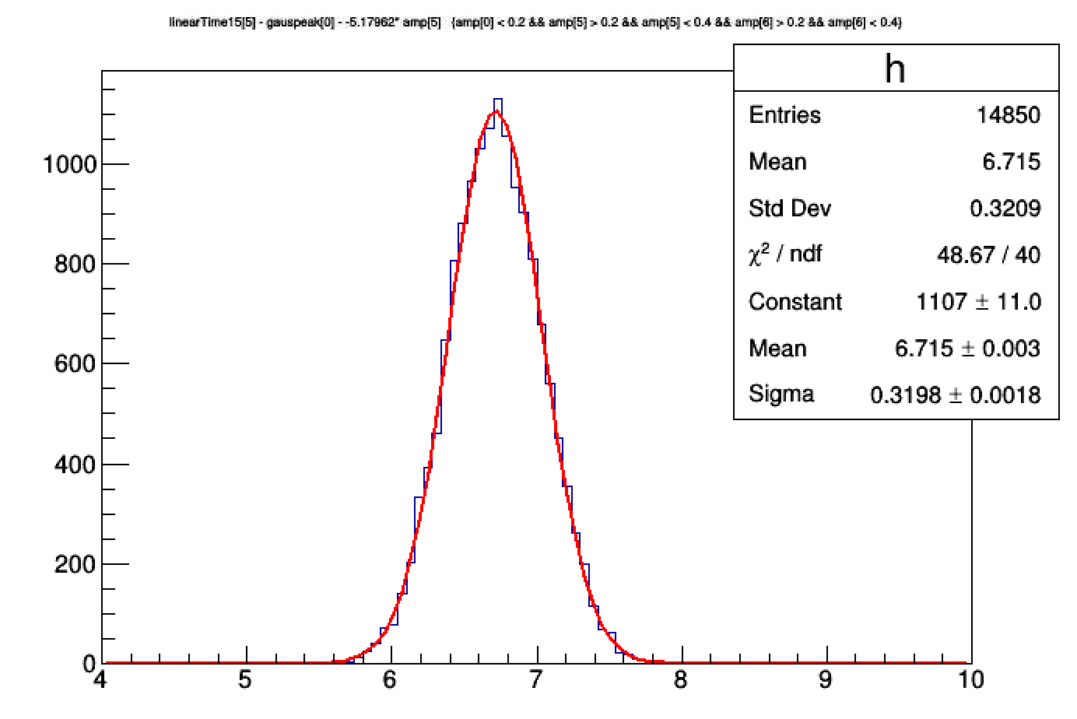
Time Stamp from Analog Pulse
Use the time stamp from the analog pulse and check how it behaves vs position
LinearTime15 channel 5 with respect to Photek reference time gives 320ps resolution after amplitude correction
Similarly, channel 6 also gets the same result
With linearTime45, we get 306 ps , so it’s very similar

Slide 11
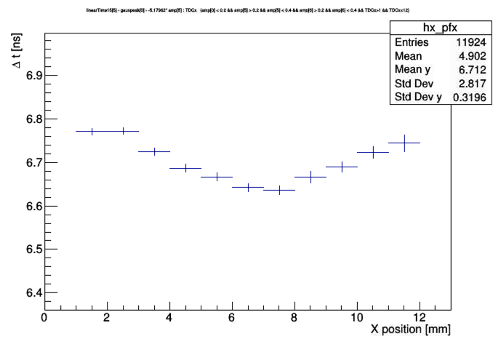
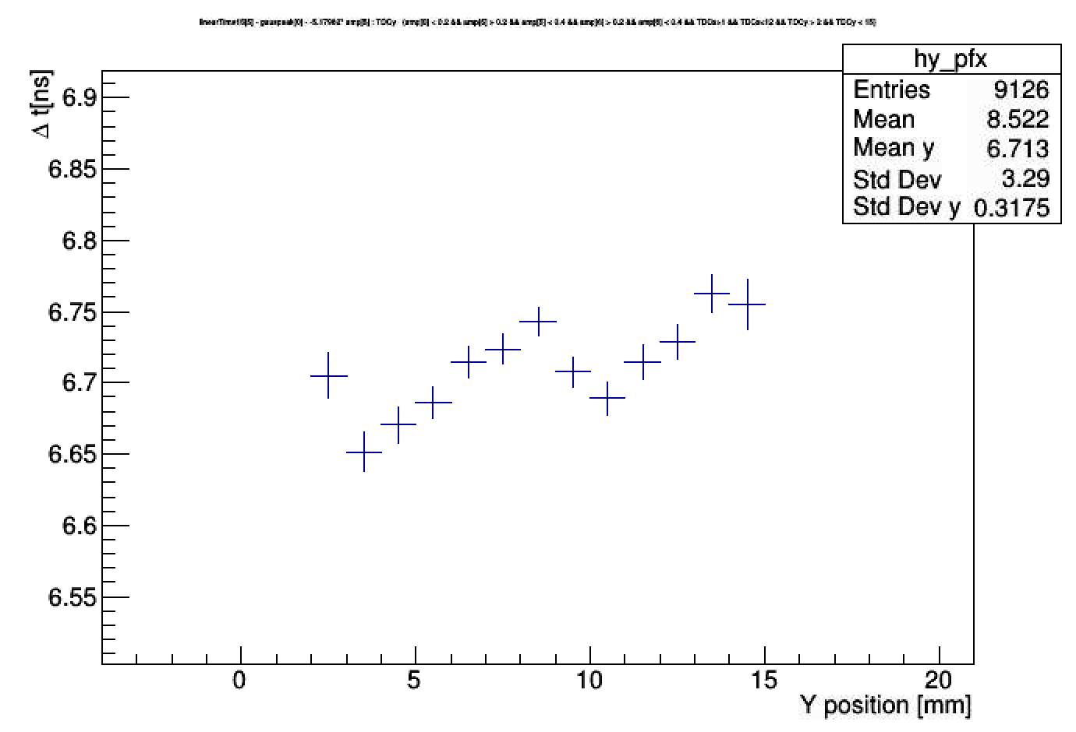
Time Stamp from Analog Pulse
Use the time stamp from the analog pulse and check how it behaves vs position
Sensor 5 timestamp with respect to Photek timestamp

Slide 12
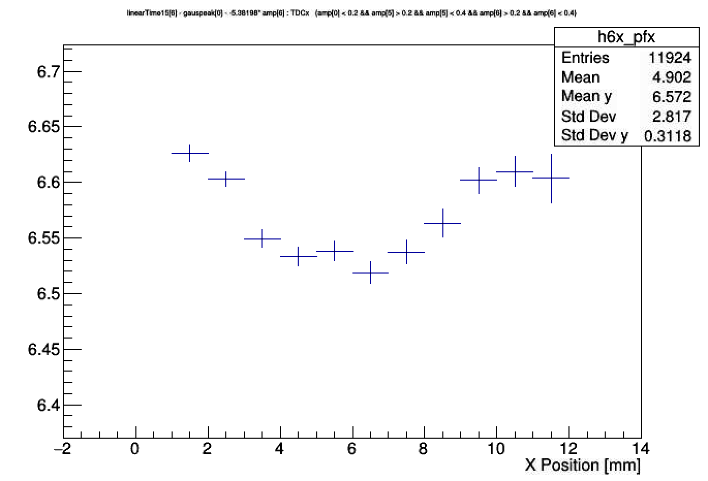
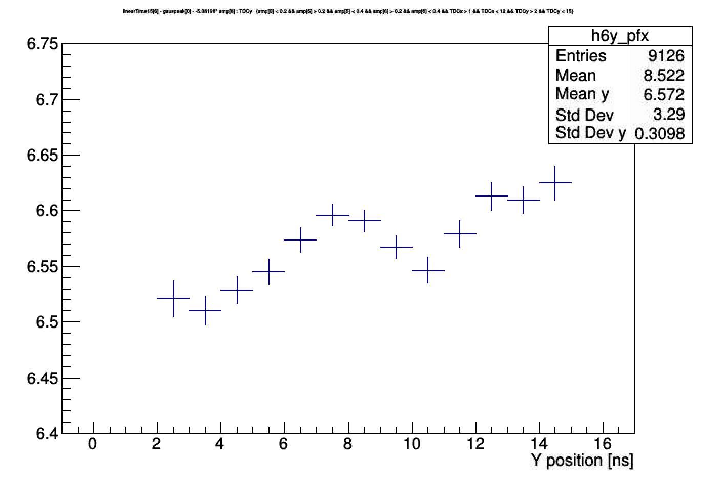
Time Stamp from Analog Pulse
Use the time stamp from the analog pulse and check how it behaves vs position
Sensor 6 timestamp with respect to Photek timestamp

Slide 13
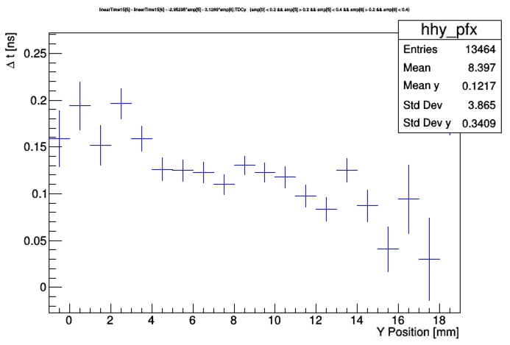
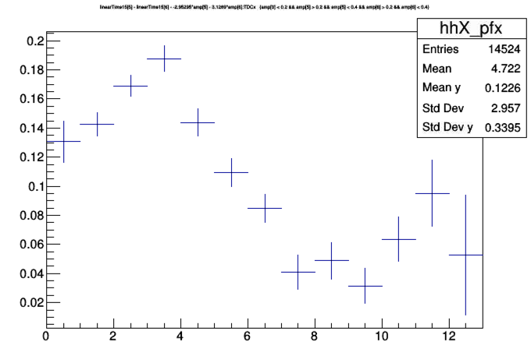
Time Stamp from Analog Pulse
Use the time stamp from the analog pulse and check how it behaves vs position
Sensor 5 timestamp – Sensor 6 timestamp

Slide 14
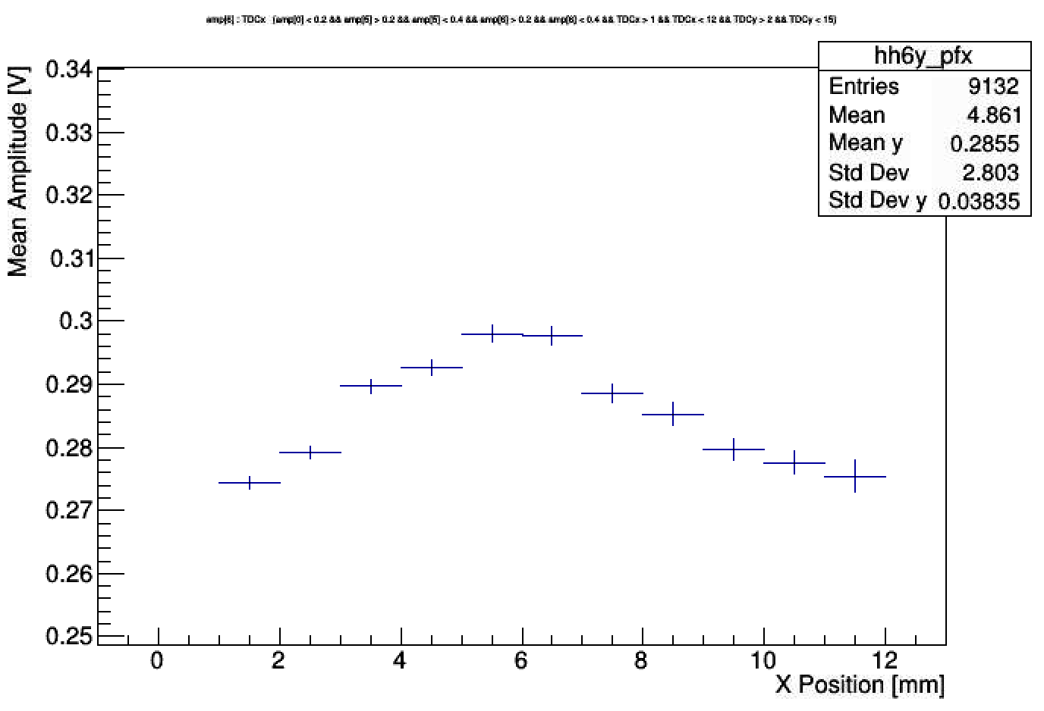
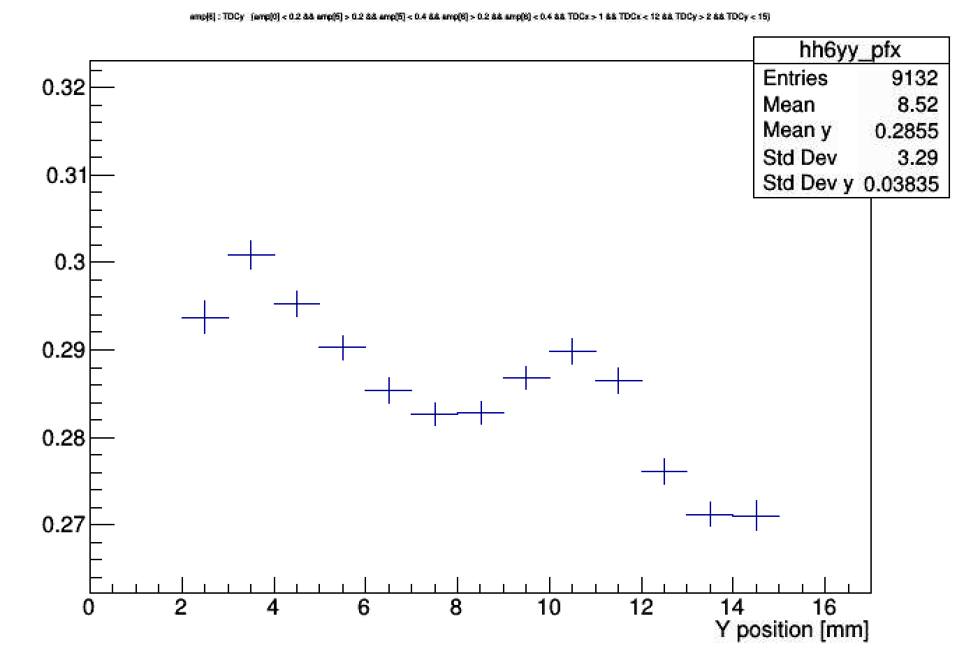
Sensor 6 Amplitude
Use Runs 7803-7830, d

