Slide 1
FNAL Testbeam Results on LYSO+SiPM
Adi Bornheim, Jay Lawhorn, Aashrita Mangu, Cristián Peña, Maria Spiropulu, Si Xie, Zhicai, Zhang
California Institute of Technology
Artur Apresyan, Sergey Los
FNAL
CMS Timing Meeting
05/26/2016

Slide 2
FNAL Testbeam Results on LYSO+SiPM
Adi Bornheim, Jay Lawhorn, Aashrita Mangu, Cristián Peña, Maria Spiropulu, Si Xie, Zhicai, Zhang
California Institute of Technology
Artur Apresyan, Sergey Los
FNAL
CMS Timing Meeting
05/26/2016

Slide 3
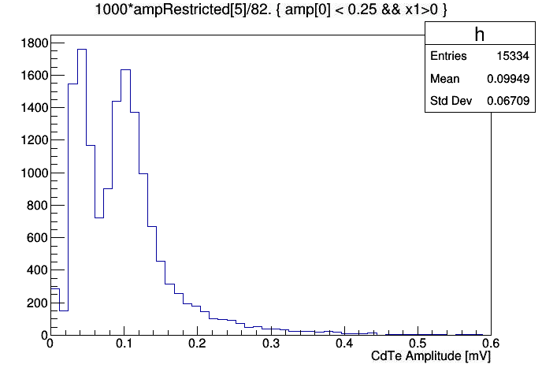
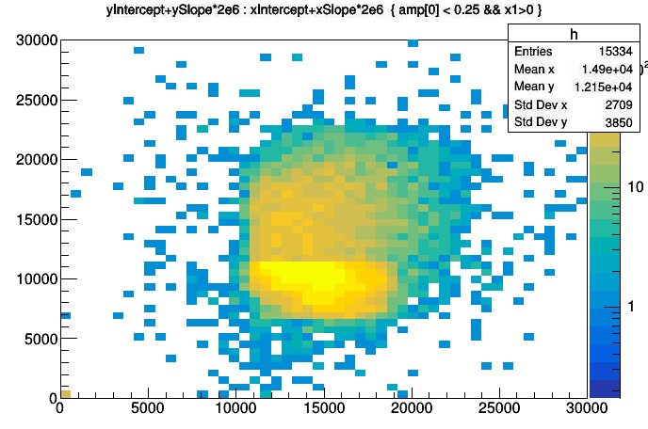
MIP Measurements
Data Used: data/Skim/CdTe/Run1268-1310_RECO_NoRinging.root
Sensor was located behind the telescope inside the UCSC frame (roughly ~2m from center of telescope)
Track position computed at z = 200mm from center of telescope
Cuts: Photek amplitude > 0.1V and < 0.25V
CdTe channel passes “Ringing filter”
Track Position [X,Y] for those cuts

Slide 4
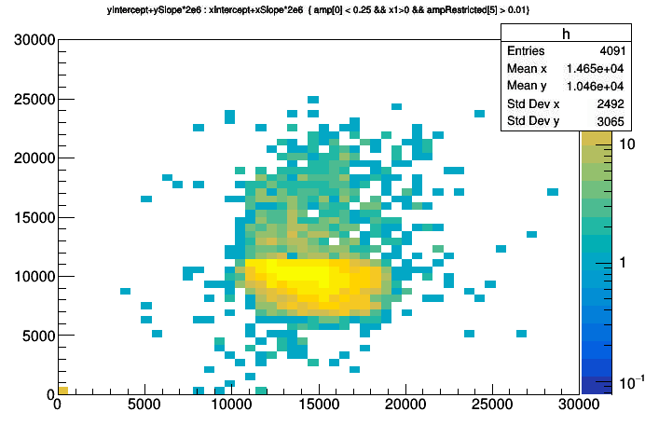
MIP Measurements
Track position computed at z = 200mm from center of telescope
Sensor outline
(1cm x 1cm)
Cuts: Photek amplitude > 0.1V and < 0.25V
CdTe channel passes “Ringing filter”
Add CdTe amplitude > 0.12 mV cut
Note that the beam was not super well aligned with the sensor, and therefore we did not capture the full width of the sensor. Instead we only captured about 8mm in X, and 4.5mm in Y. The beam drops off below around Y=6mm, the pixel telescope coverage ends below X~11mm

Slide 5
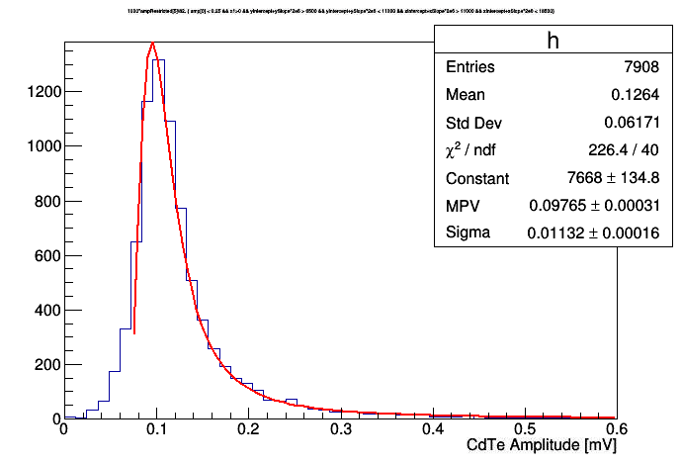
MIP Measurements
Track position computed at z = 200mm from center of telescope
Cuts: Photek amplitude > 0.1V and < 0.25V
CdTe channel passes “Ringing filter”
Require track position within fiducial area of the sensor:
X: (11mm, 18.5mm)
Y: (6.5mm, 11.3mm)

Slide 6
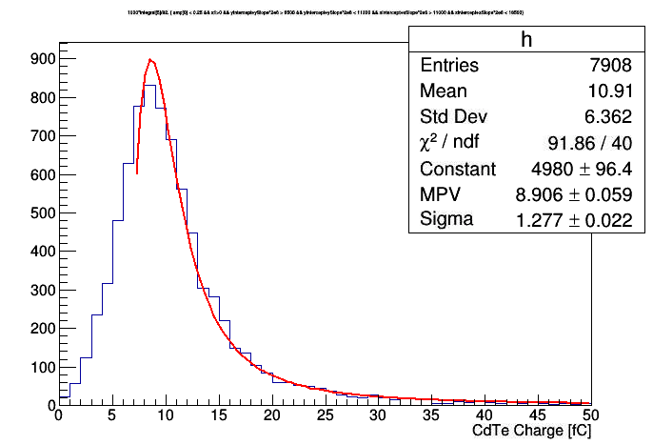
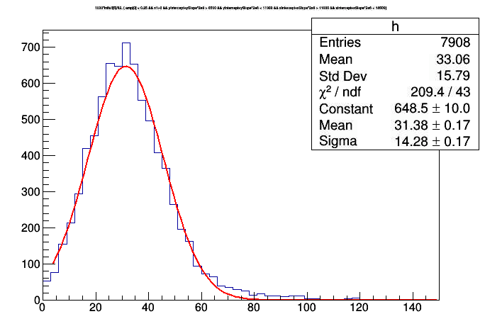
MIP Measurements
MIP signal charge
I’m still concerned whether the baseline has been fitted well. If not then the charge measurement has a pedestal bias which will affect our interpretation of the measured value and the comparison with showers
Integrate a window around the peak
[-25 bins, +50 bins]
Peak and falling edge fits landau well, but low edge does not. Low edge may possibly have background?
Integrate the full sampling range (1024 bins)
Shape becomes gaussian too for some reason

Slide 7
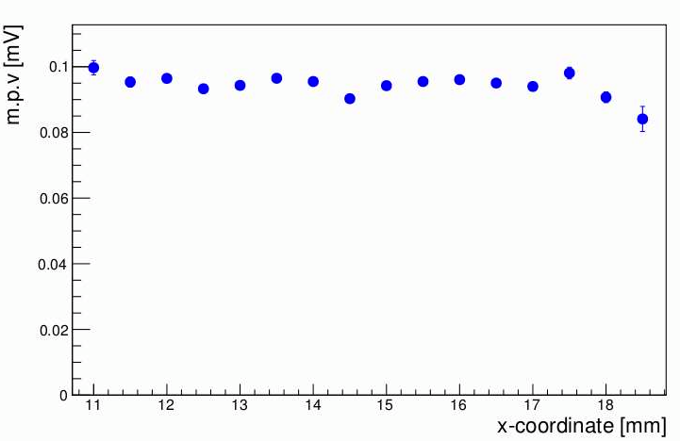
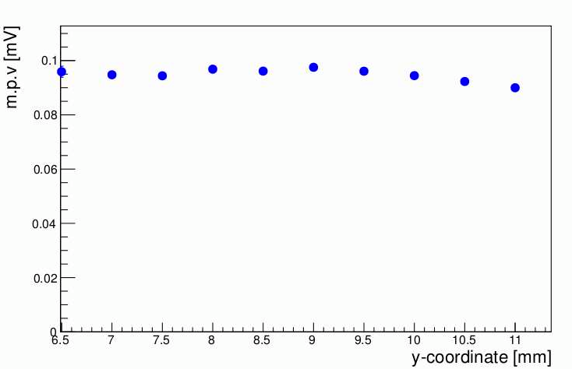
MIP Measurements
MIP signal amplitude
Note that the beam was not super well aligned with the sensor, and therefore we did not capture the full width of the sensor. Instead we only captured about 8mm in X, and 4.5mm in Y
MIP signal amplitude is stable vs particle position

Slide 8
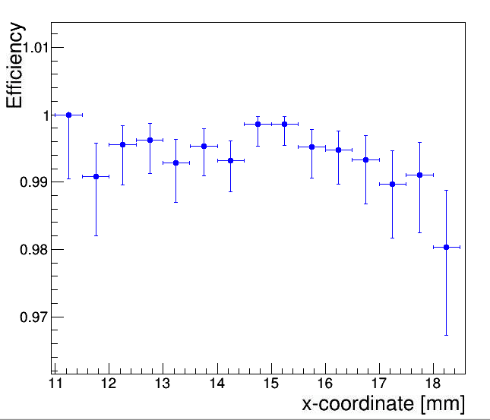
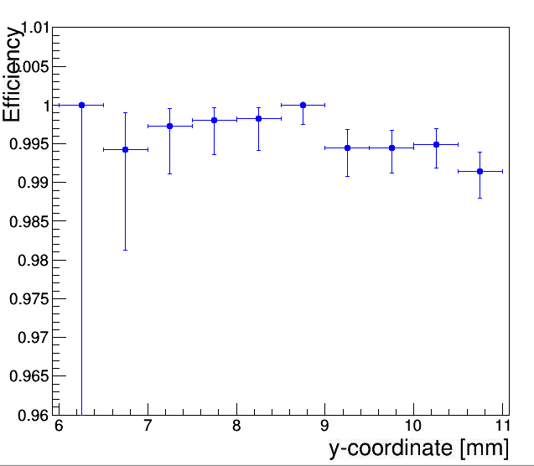
MIP Efficiency
Efficiency above 99%
Use amplitude > 0.04 mV to define numerator

Slide 9
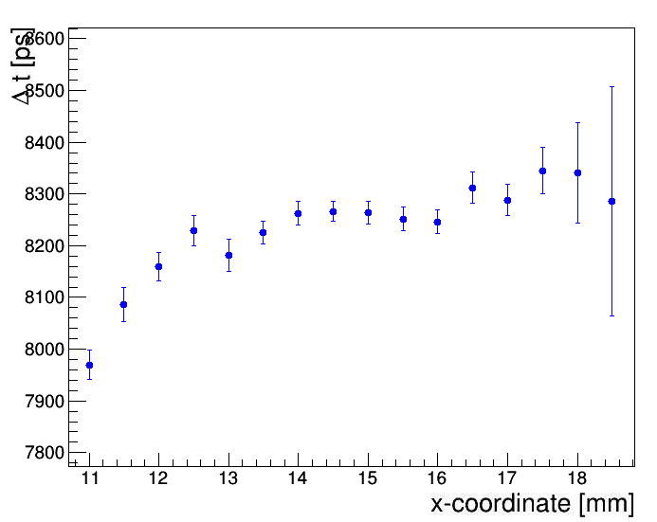
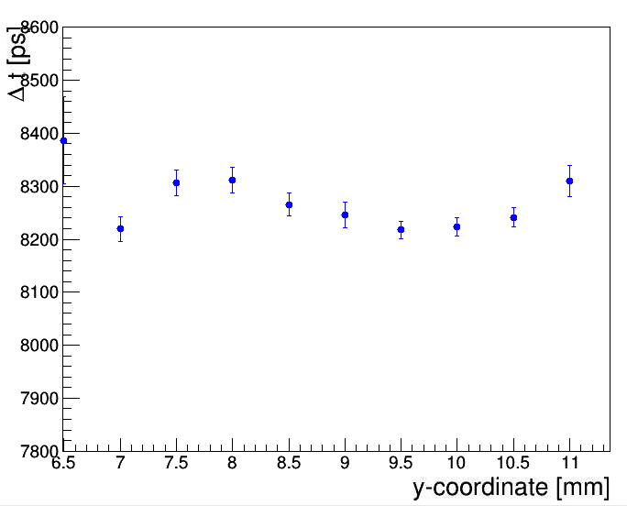
MIP Timing
Use pulses with amplitude > 0.03 mV
There’s some structure vs position. Need to check if it’s consistent with what we saw previously

Slide 10
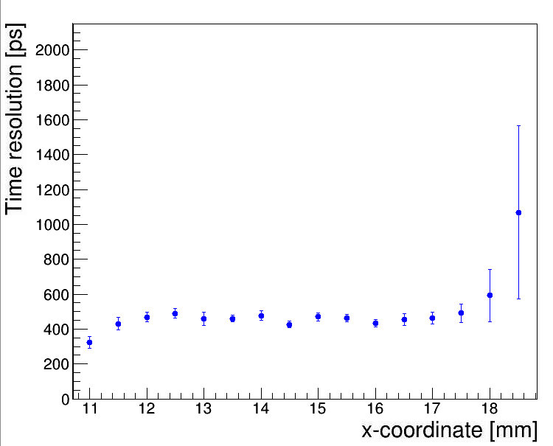
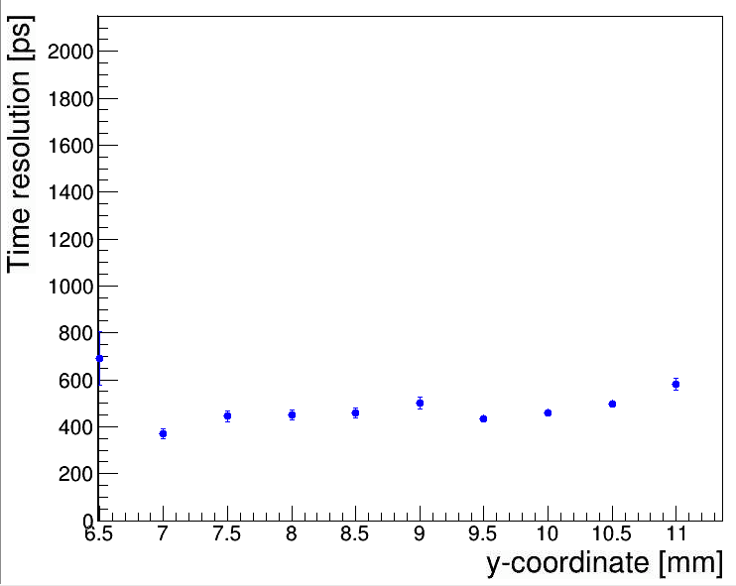
MIP Timing
Time resolution is about 450ps

Slide 11
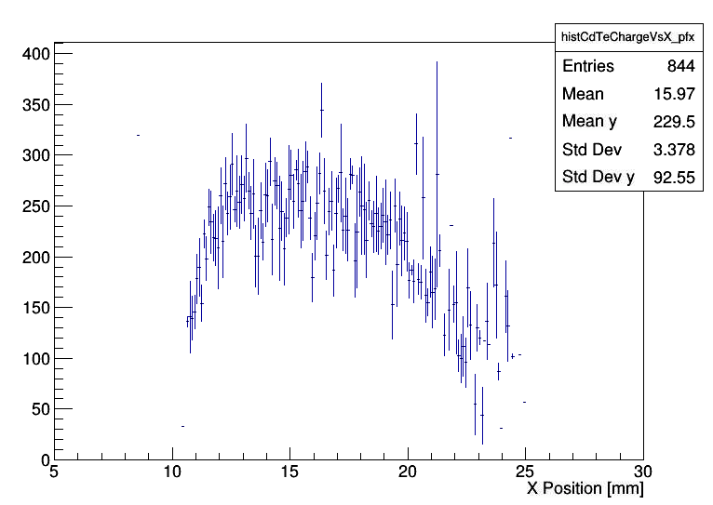
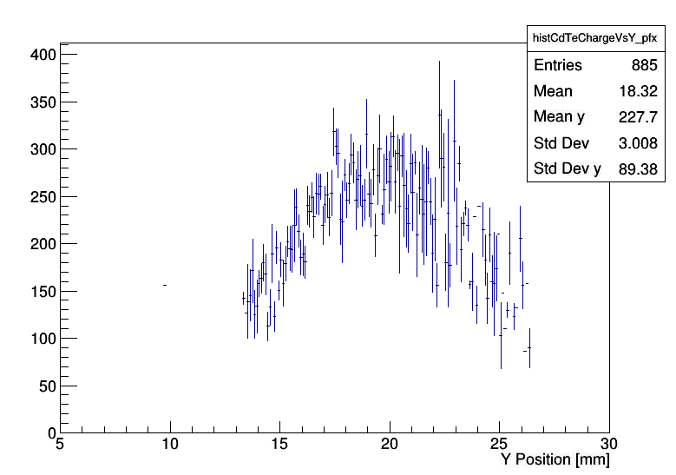
CdTe
Absorber | 5-7mm Air gap | Silicon Pad | 5-7mm Air gap | CdTe
Choose region:
X: 12 – 19 mm
Y: 16 – 23 mm

Slide 12
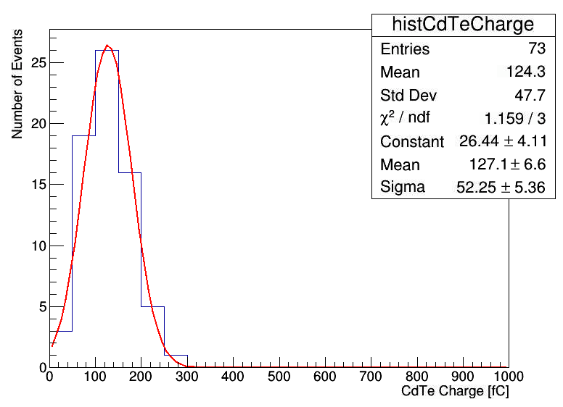
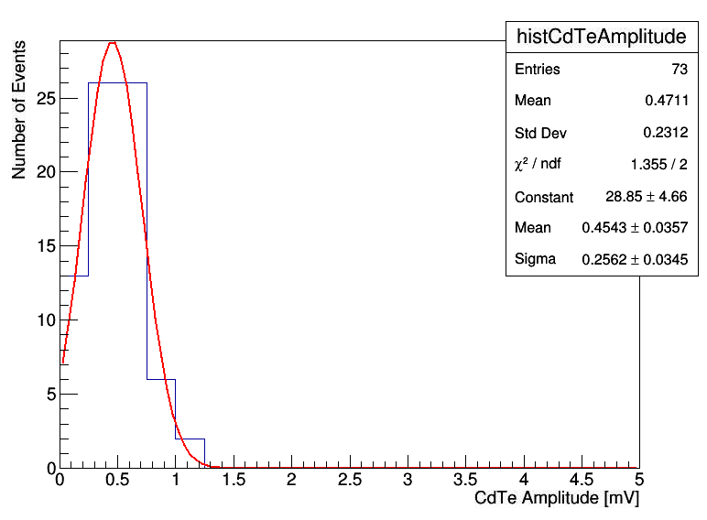
CdTe
Absorber | 5-7mm Air gap | Silicon Pad | 5-7mm Air gap | CdTe
2X0 Lead

Slide 13
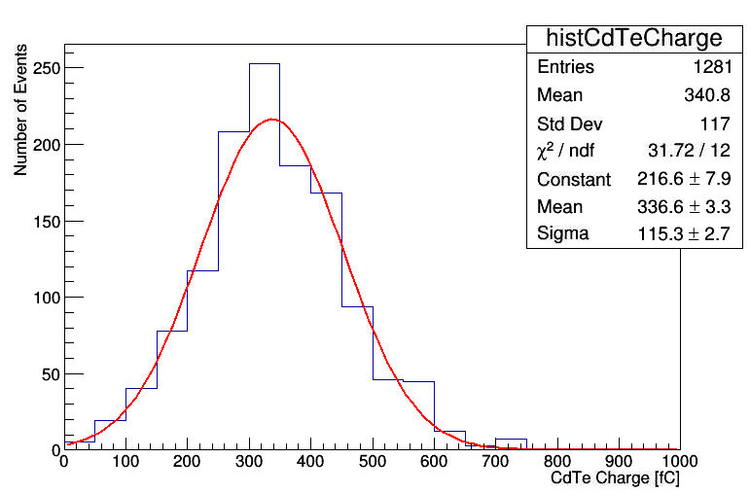
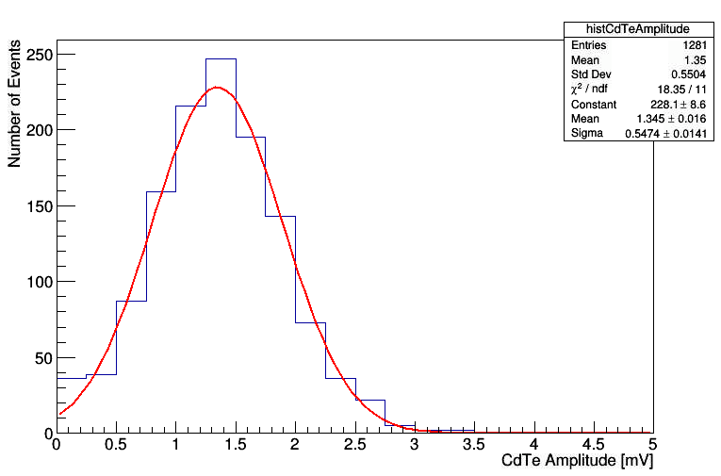
CdTe
Absorber | 5-7mm Air gap | Silicon Pad | 5-7mm Air gap | CdTe
4X0 Lead

Slide 14
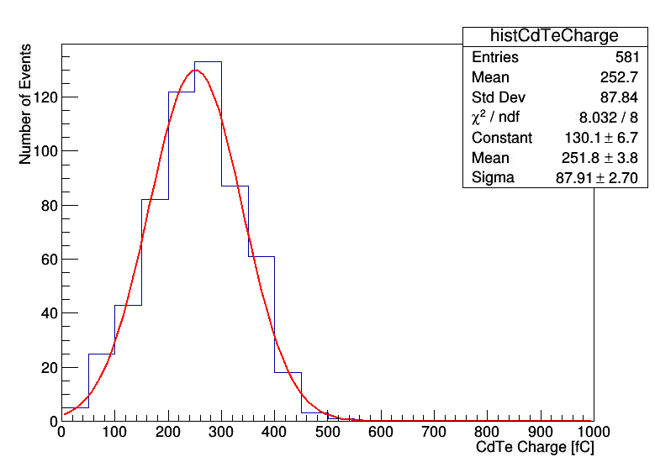
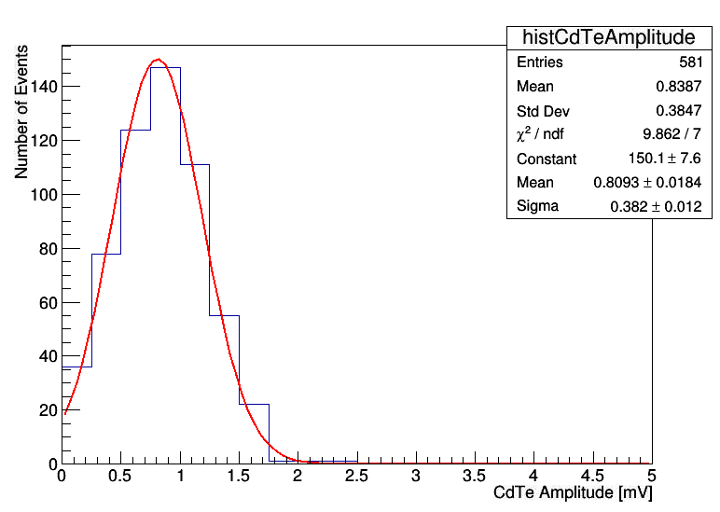
CdTe
Absorber | 5-7mm Air gap | Silicon Pad | 5-7mm Air gap | CdTe
6X0 Lead

Slide 15
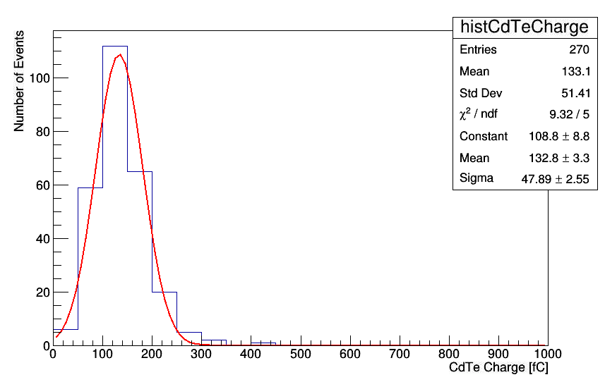
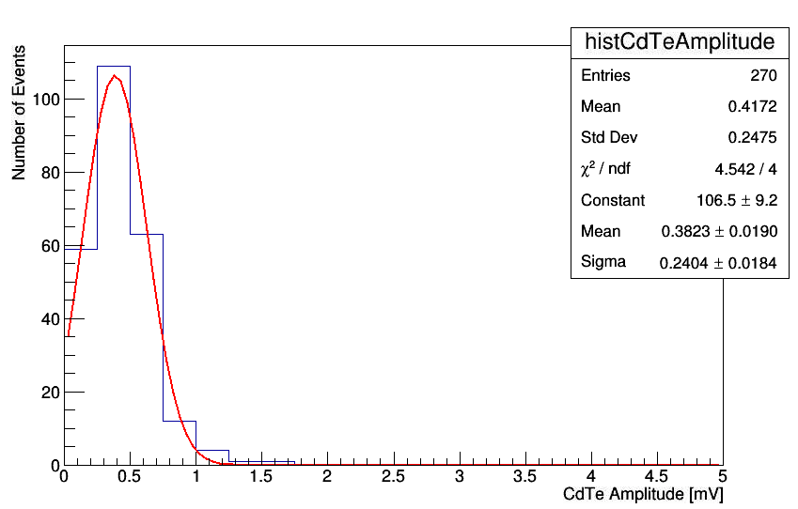
CdTe
Absorber | 5-7mm Air gap | Silicon Pad | 5-7mm Air gap | CdTe
4.3X0 Tungsten + 6X0 Lead = 10.3 X0

Slide 16
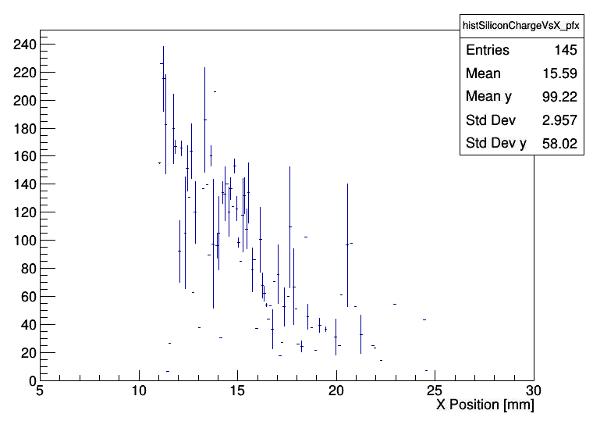
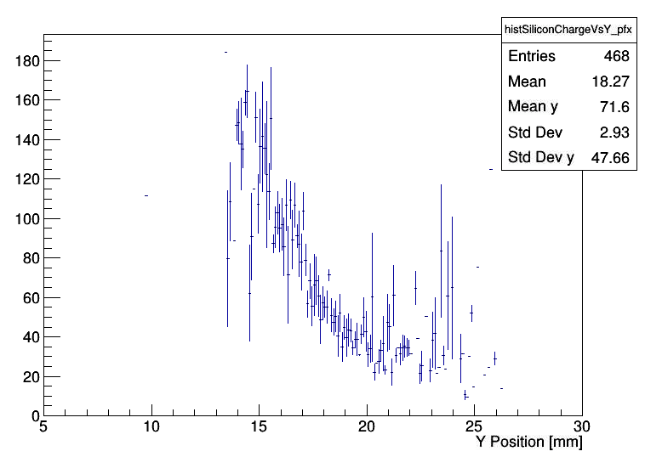
Silicon
Absorber | 5-7mm Air gap | Silicon Pad | 5-7mm Air gap | CdTe
Silicon and CdTe sensor were offset with respect to each other.
Clearly we didn’t sample the center of the shower for the silicon case
Choose region:
X: 11.5 – 15 mm
Y: 13 – 15 mm

Slide 17
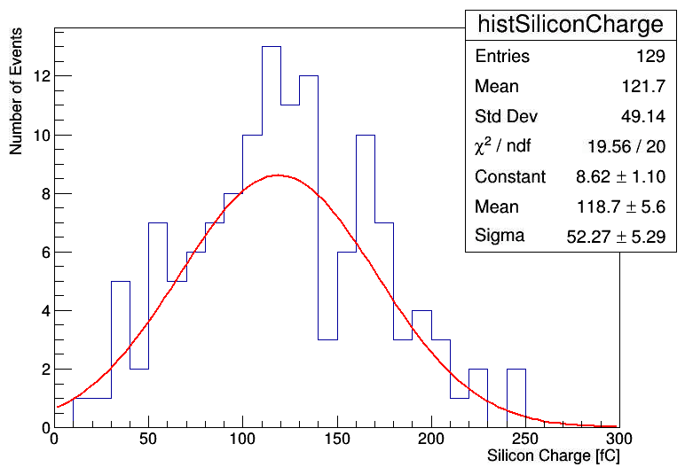
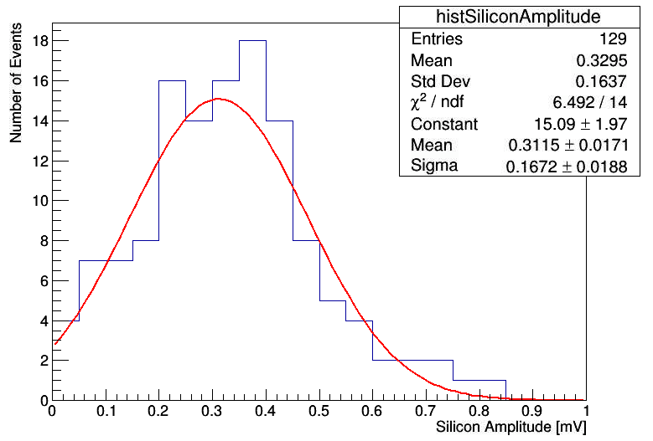
Silicon
Absorber | 5-7mm Air gap | Silicon Pad | 5-7mm Air gap | CdTe
4X0 Lead

Slide 18
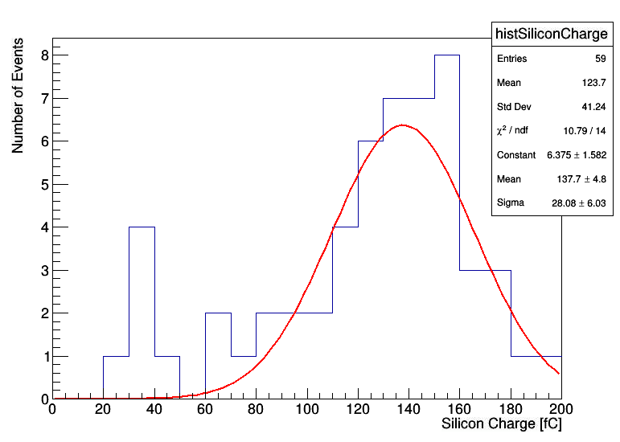
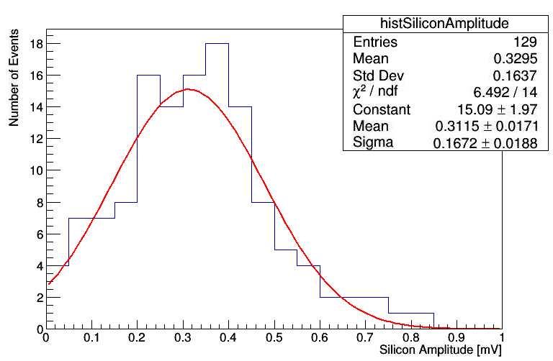
Silicon
Absorber | 5-7mm Air gap | Silicon Pad | 5-7mm Air gap | CdTe
6X0 Lead

Slide 19
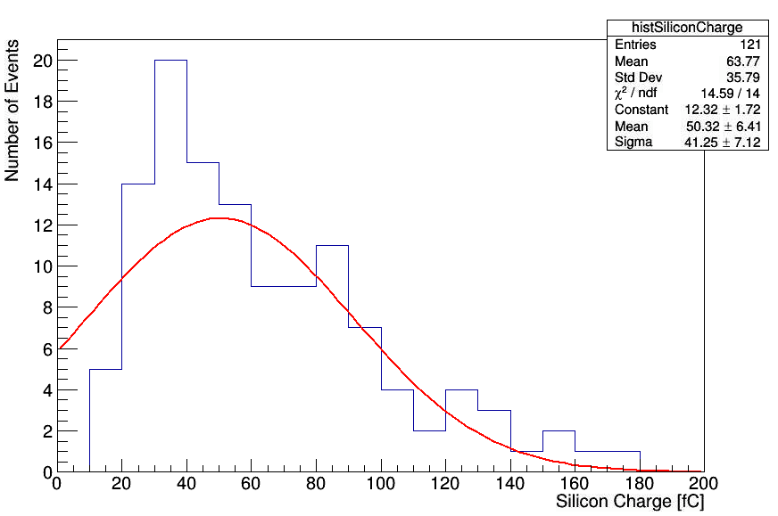
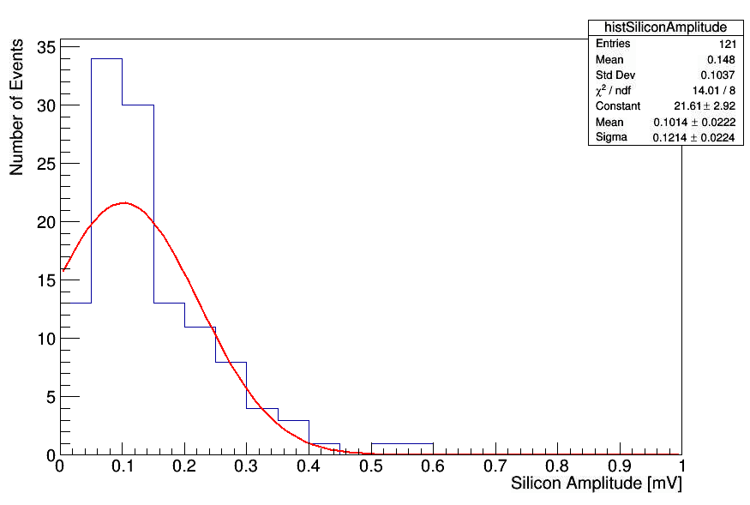
Silicon
Absorber | 5-7mm Air gap | Silicon Pad | 5-7mm Air gap | CdTe
4.3X0 Tungsten + 6X0 Lead = 10.3 X0

Slide 20
Absorber | 5-7mm Air gap | CdTe | 5-7mm Air gap | Silicon Pad

Slide 21
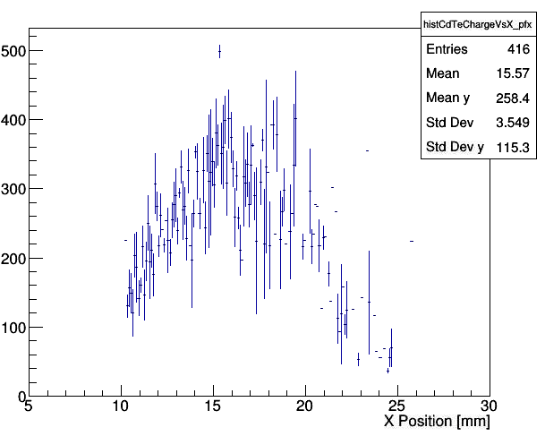
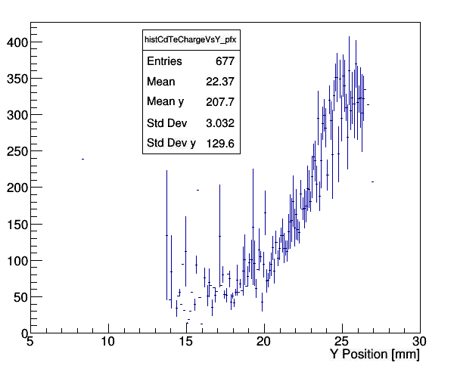
CdTe
Absorber | 5-7mm Air gap | Silicon Pad | 5-7mm Air gap | CdTe
Choose region:
X: 14 – 20 mm
Y: 24 – 26 mm
Alignment is off-center in Y
But it’s maybe enough to get some of the center region

Slide 22
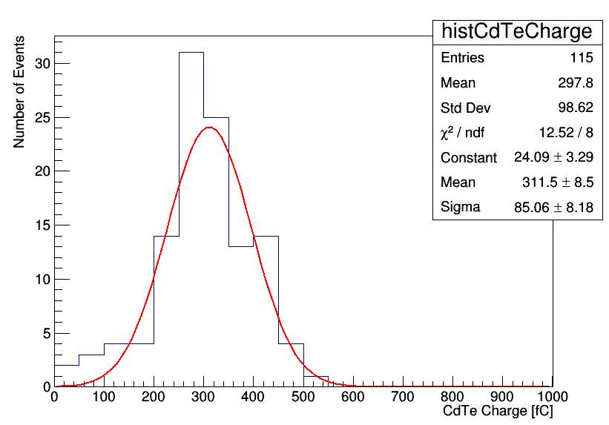
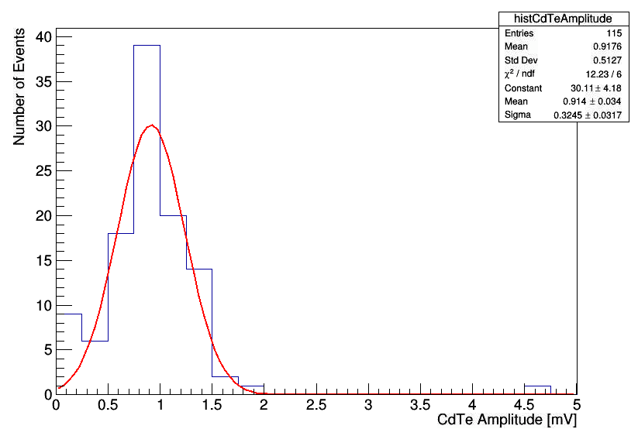
CdTe
Absorber | 5-7mm Air gap | CdTe | 5-7mm Air gap | Silicon Pad
4X0 Lead

Slide 23
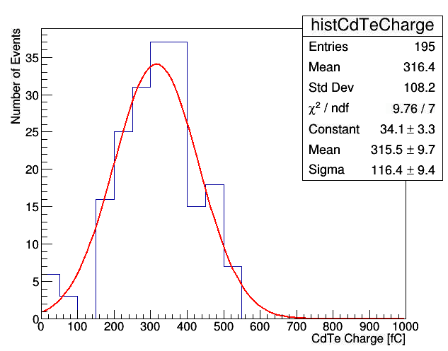
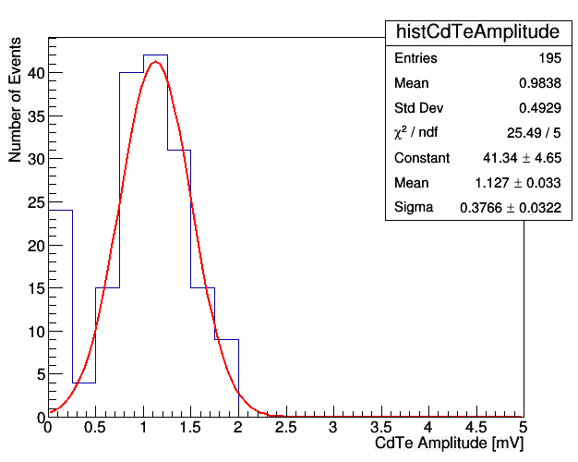
CdTe
Absorber | 5-7mm Air gap | CdTe | 5-7mm Air gap | Silicon Pad
6X0 Lead

Slide 24
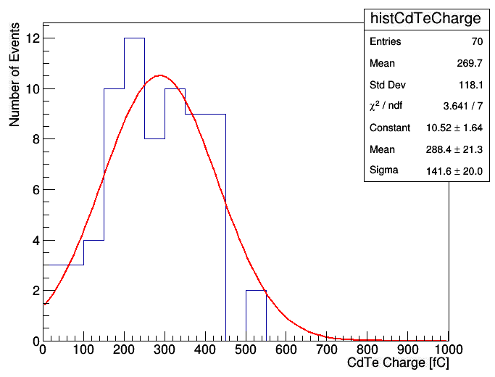
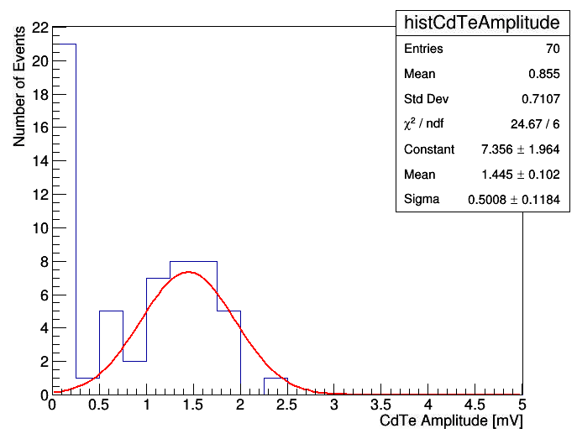
CdTe
Absorber | 5-7mm Air gap | CdTe | 5-7mm Air gap | Silicon Pad
4.3X0 Tungsten + 6X0 Lead = 10.3 X0

Slide 25
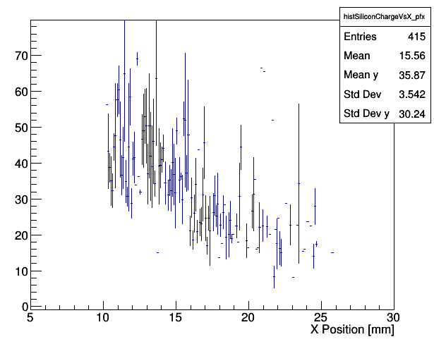
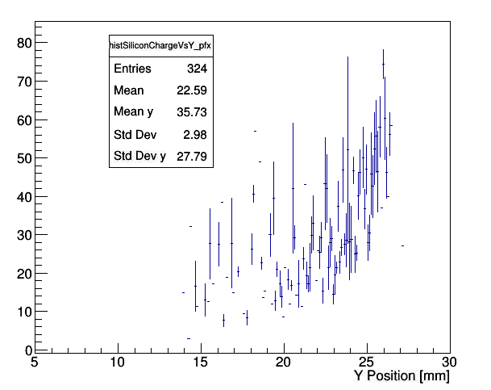
Silicon
Absorber | 5-7mm Air gap | Silicon Pad | 5-7mm Air gap | CdTe
Choose region:
X: 10.5 – 13 mm
Y: 24 – 26 mm
Alignment is off-center in X and Y, but it’s maybe enough to get some of the center region

Slide 26
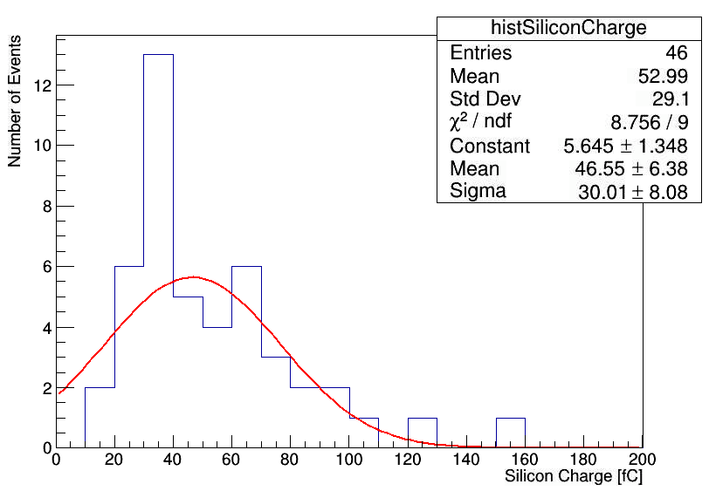
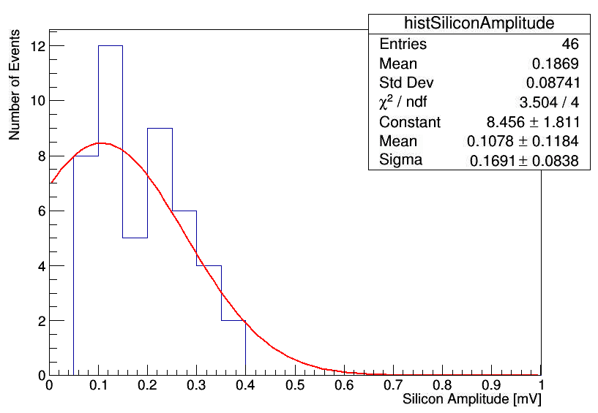
Silicon
Absorber | 5-7mm Air gap | CdTe | 5-7mm Air gap | Silicon Pad
4X0 Lead

Slide 27
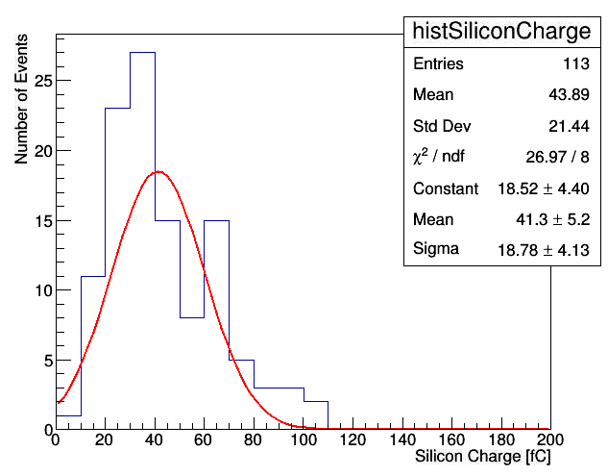
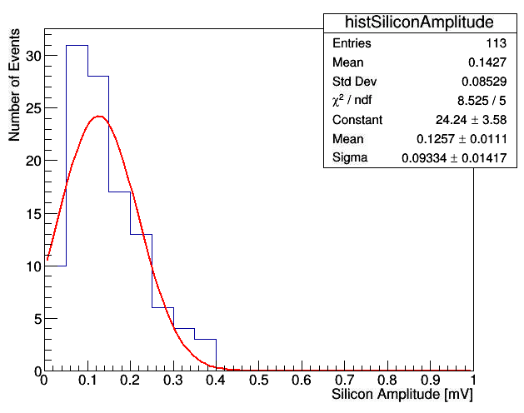
Silicon
Absorber | 5-7mm Air gap | CdTe | 5-7mm Air gap | Silicon Pad
6X0 Lead

Slide 28
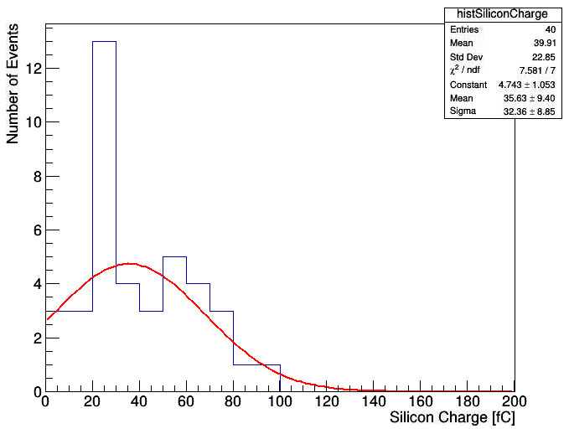
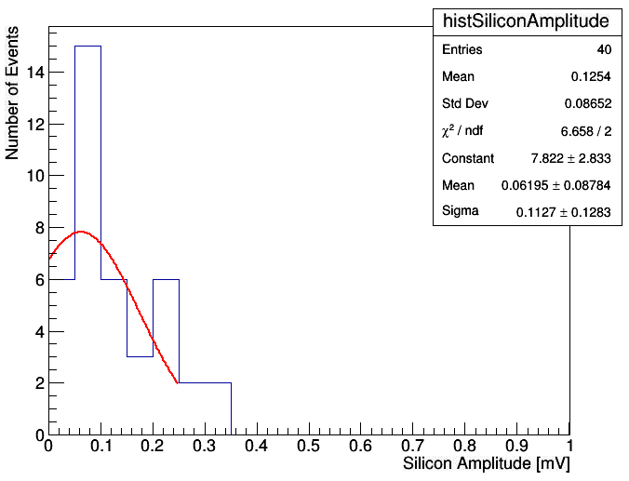
Silicon
Absorber | 5-7mm Air gap | CdTe | 5-7mm Air gap | Silicon Pad
4.3X0 Tungsten + 6X0 Lead = 10.3 X0

Slide 29
Shower Signal Comparison
Absorber | 5-7mm Air gap | CdTe | 5-7mm Air gap | Silicon Pad
Absorber | CdTe Mean Charge | Silicon Mean Charge | Mean Charge Ratio
2X0 Lead | 127 fC | No data
4X0 Lead | 337 fC | 119 fC | 2.8
6X0 Lead | 252 fC | 138 fC | 1.8
4.3W + 6X0Lead | 133 fC | 50 fC | 2.7
Absorber | 5-7mm Air gap | CdTe | 5-7mm Air gap | Silicon Pad
Absorber | CdTe Mean Charge | Silicon Mean Charge | Mean Charge Ratio
4X0 Lead | 312 fC | 47 fC | 6.6
6X0 Lead | 316 fC | 41 fC | 7.7
4.3W + 6X0Lead | 288 fC | 36 fC | 8.0

Slide 30
Shower Signal Comparison
From previous slide, clearly the air gaps make a big difference
Let’s compare the signals under the same air gap distance
Sensor Located after first air gap
Absorber | CdTe Mean Charge | Silicon Mean Charge | Mean Charge Ratio
4X0 Lead | 312 fC | 119 fC | 2.6
6X0 Lead | 316 fC | 138 fC | 2.3
4.3W + 6X0Lead | 288 fC | 50 fC | 5.8
Sensor Located after 2nd air gap
Absorber | CdTe Mean Charge | Silicon Mean Charge | Mean Charge Ratio
4X0 Lead | 337 fC | 47 fC | 7.2
6X0 Lead | 252 fC | 41 fC | 6.1
4.3W + 6X0Lead | 133 fC | 36 fC | 3.7

Slide 31
Shower Signal Comparison
At 10X0, CdTe seems to see a bigger signal that disappears if we place it after the silicon sensor + copper box + air gaps
  Maybe the x-ray photons get absorbed in the copper / air?
Sensor Located after first air gap
Absorber | CdTe Mean Charge | Silicon Mean Charge | Mean Charge Ratio
4X0 Lead | 312 fC | 119 fC | 2.6
6X0 Lead | 316 fC | 138 fC | 2.3
4.3W + 6X0Lead | 288 fC | 50 fC | 5.8
Sensor Located after 2nd air gap
Absorber | CdTe Mean Charge | Silicon Mean Charge | Mean Charge Ratio
4X0 Lead | 337 fC | 47 fC | 7.2
6X0 Lead | 252 fC | 41 fC | 6.1
4.3W + 6X0Lead | 133 fC | 36 fC | 3.7

Slide 32
Shower Signal Comparison
These ratios are too small compared to expectation ( even if there are no x-ray photons, ratio should be ~5)
Need to understand if it’s because silicon charge is biased by imperfect pedestal subtraction. It’s better if we can amplify the silicon more so that it suffers less from pedestal
Sensor Located after first air gap
Absorber | CdTe Mean Charge | Silicon Mean Charge | Mean Charge Ratio
4X0 Lead | 312 fC | 119 fC | 2.6
6X0 Lead | 316 fC | 138 fC | 2.3
4.3W + 6X0Lead | 288 fC | 50 fC | 5.8
Sensor Located after 2nd air gap
Absorber | CdTe Mean Charge | Silicon Mean Charge | Mean Charge Ratio
4X0 Lead | 337 fC | 47 fC | 7.2
6X0 Lead | 252 fC | 41 fC | 6.1
4.3W + 6X0Lead | 133 fC | 36 fC | 3.7

Slide 33
Shower Signal Comparison
Also the ratio changes a lot between the first air gap and 2nd air gap.
Is it due to spread of shower in transverse direction? The silicon pad is smaller in area compared to CdTe.
Sensor Located after first air gap
Absorber | CdTe Mean Charge | Silicon Mean Charge | Mean Charge Ratio
4X0 Lead | 312 fC | 119 fC | 2.6
6X0 Lead | 316 fC | 138 fC | 2.3
4.3W + 6X0Lead | 288 fC | 50 fC | 5.8
Sensor Located after 2nd air gap
Absorber | CdTe Mean Charge | Silicon Mean Charge | Mean Charge Ratio
4X0 Lead | 337 fC | 47 fC | 7.2
6X0 Lead | 252 fC | 41 fC | 6.1
4.3W + 6X0Lead | 133 fC | 36 fC | 3.7

Slide 34
Summary
ss

Slide 35
Backups

