Slide 1
High precision timing for HL-LHC

Slide 2
100 GeV π⁻
Time of geant hits with E>0.5 GeV in a crystal in EB at ieta ≈ 8 and iphi ≈ 10.
4.35 ns corresponds to ≈1.3 m, the distance from the IP to the crystal.

Slide 3
Particle gun aims at one particular crystal.
Spread illustrates the spatial size of the shower.

Slide 4
Time vs energy : Low energy hits may be very delayed in time

Slide 5
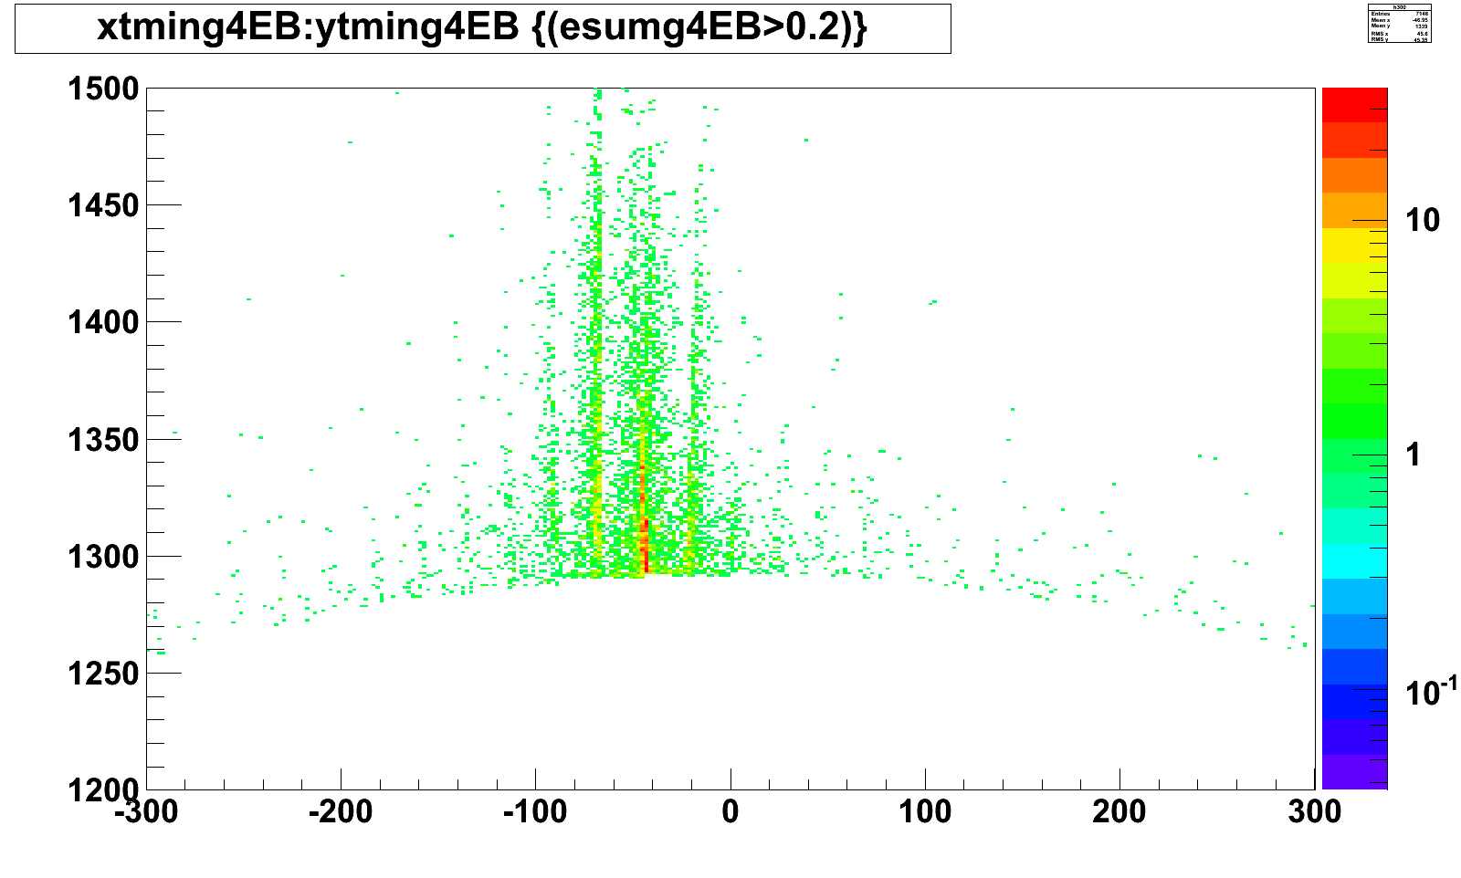
x-y map of the first hits : ECAL radius ≈1300 mm
Note crystal structure

